Slide 1
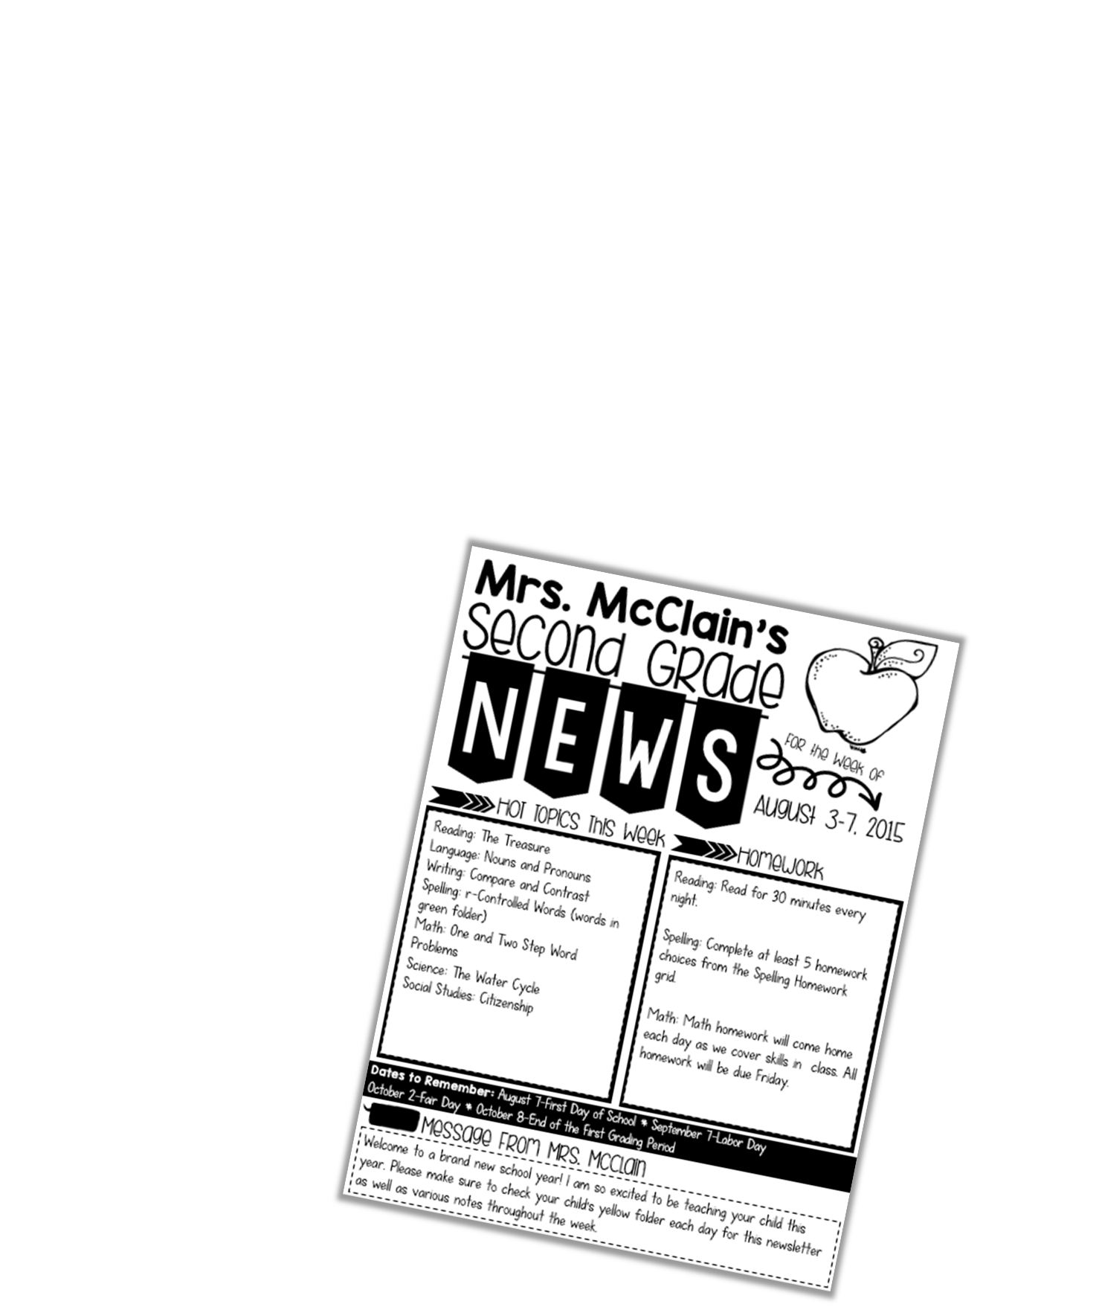

Slide 2
Mrs. Gonzales’
Kindergarten
November 5-9
This month:
Learning:
November 6: Election Day
November 7: Picture Retake Day
November 9: Family Game Night @ 6p.m.
November 16: Midterms sent home
November 17: Toledo Blade Holiday Parade
November 21-23: Thanksgiving Break
November 30: $1 Jean Day
This week we are:
-introducing word families
-naming ending sounds
-sounding out CVC words
-retelling stories using key details
-introducing the sight words: with, his, they, at, be
-continuing to label and include speech bubbles during Writer’s Workshop
-counting to 100 by tens and ones
-counting up to 20 objects and stating ”how many” there are
-describing 2D shapes
-introducing 3D shapes
-comparing 2D and 3D shapes
Homework Packet #9 will be due Friday, November 9th!
Class website: www.gonzalesgradek.weebly.com
I am so thankful for all of the parents/ guardians who came to conferences this past week! Remember that the skills that were taught in first quarter are the foundation for everything we learn the rest of the year! Students will not be able to read words and sentences if they do not know all their letters and letter sounds yet!

Slide 3
YOUR TEXT
YOUR TEXT
YOUR TEXT
YOUR TEXT
YOUR TEXT
YOUR TEXT
YOUR TEXT
YOUR TEXT: YOUR TEXT
YOUR TEXT
YOUR TEXT

