Slide 1
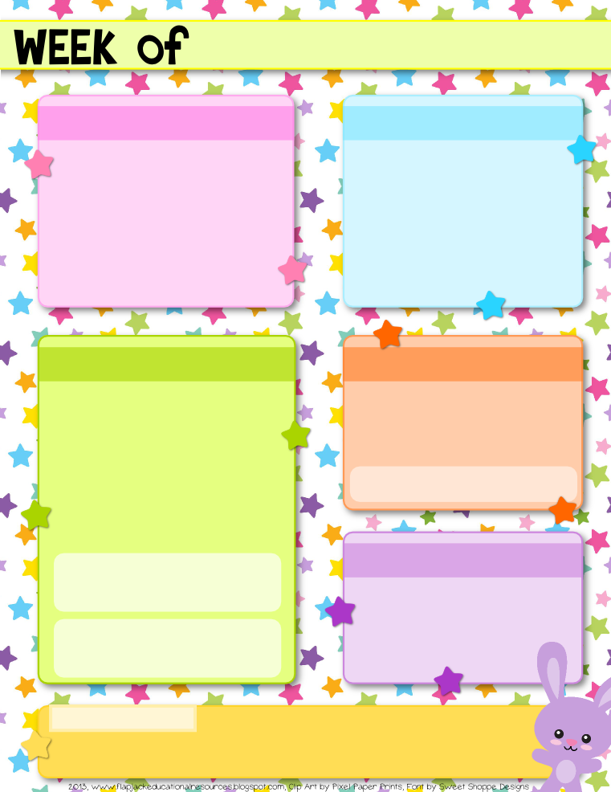
Welcome!
Kindergarten
Class Dojo
By the end of the year, your kindergartener will be expected to know all letters and letter sounds, 100 sight words, be able to count to 100 by tens and ones, be able to rhyme, be able to read small words (ex. cat, yet, sun), along with other standards. All of these goals are possible and easily accomplished with good attendance, a positive attitude toward school, and by practicing at home!
Class Dojo is a website/app that is used school-wide. Class Dojo allows for easy teacher-parent communication through messaging. Class Dojo is also used to track your child’s behavior throughout the day. He/she will gain points for being on task throughout the day and will lose points for being off task. I will use your phone number to send you an invitation to join!
Mrs. Gonzales
Homework
This is my second year of teaching kindergarten at Imagine Madison Avenue School of Art, and I am so excited to teach your child during the 2018-2019 school year! I earned my bachelor of science in Early Childhood Education (preK-3) from The Ohio State University in 2017. When I am not teaching, I love to spend time with my husband and 3 year old daughter, Miá.
Once we are a couple weeks into the school year, I will start sending home a weekly homework packet each Monday that will be completed throughout the week and turned in each Friday! Some of the directions will need to be read to your child in order for them to complete their homework.
Take-home Folder
Ways to contact me:
Starting the first day of school, you child will have an orange take-home folder that they will need to bring to and from school everyday! This folder will contain homework, papers that need to be signed, as well as finished classwork.
Phone: 419-259-4000
E-mail: brittany.gonzales@imagineschools.org
As well as Class Dojo!
Class Website
gonzalesgradek.weebly.com
The class website contains the daily schedule, upcoming events and pictures of the class! Check the website for first day photos!

Slide 2
Before sending to parents, be sure to delete this slide and save your newsletter as a PDF file so the format will stay the same. To do this, 1) go to File, 2) Click Save as…, 3) change the format to PDF, and 4) click save.
A big thanks to Pixel Paper Prints - http://www.etsy.com/shop/pixelpaperprints and Sweet Shoppe Designs - http://www.sweetshoppedesigns.com/ for their beautiful artwork.
For more from FlapJack, click here - http://www.teacherspayteachers.com/Store/Flapjack-Educational-Resources

